Slide 1
FedEx Supply Chain Info
-Fedexsc (Magento)-
Magento URL: https://fedexscmobility.wirelesshelp.com/magentoadmin/
Login: knadmin
Pass: Imknadmin1!
User: 2751202@fedex.com Pass/123456789 Fedex Employee
Server Info (Magento)-
IP: 20.163.143.24
Port: 8092
User: clientmagentoadmin
Key File :
-Fedexsc (CSP)-
WP URL: https://fedexsc.wirelesshelp.com/wp-admin/
Login: fedexscadmin
Pass: Imfedexscadmin1!
User:
Server Info (CSP)-
IP: 20.185.155.38
Port: 8092
User: cspadmin
Key File :
Mysql: cspadmin / Imcspadmin1#

Slide 2
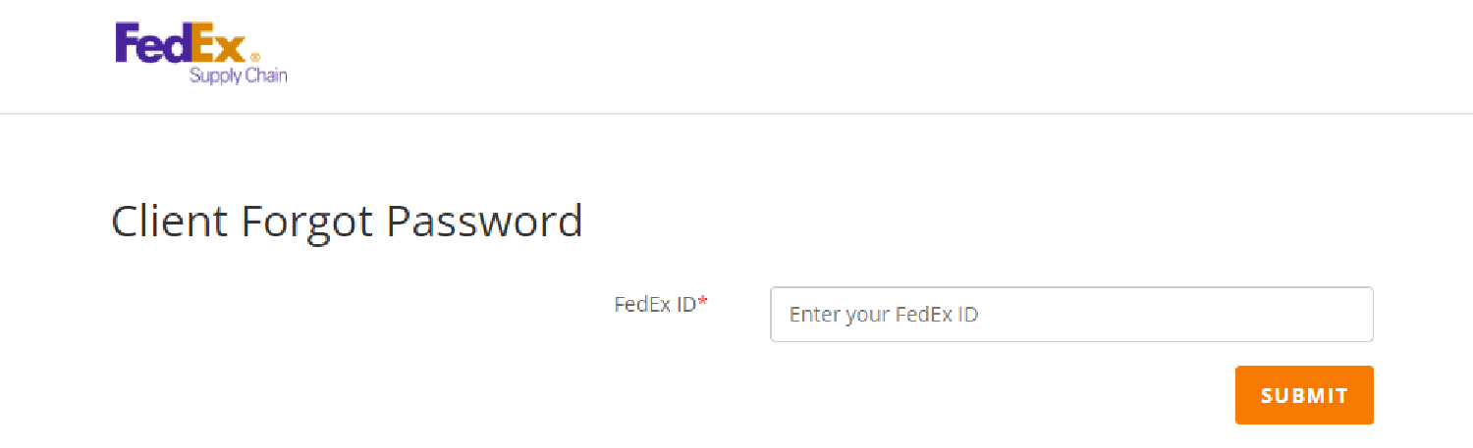
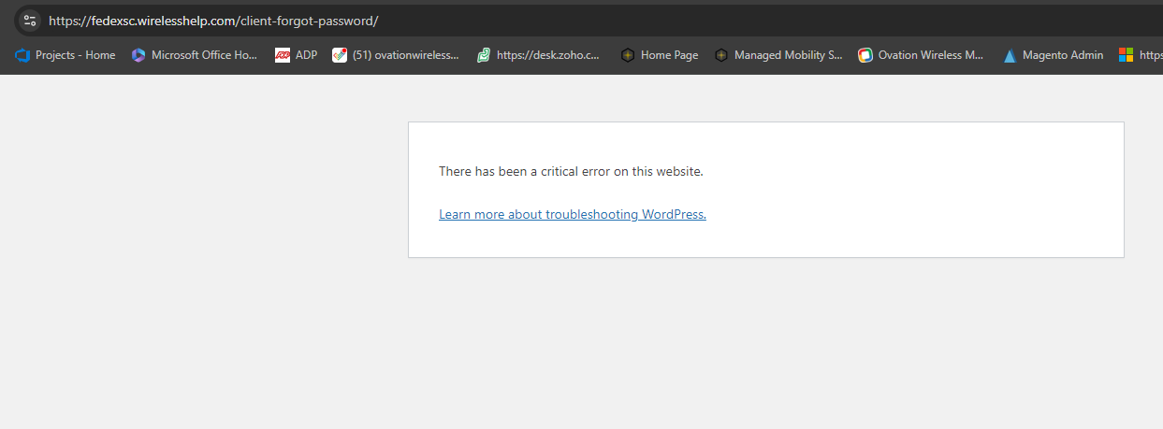
Hi Prabal -
Please take a look at this and let me know if you can fix the error.
/datadrive/csps/fedexscv2/wp-content/themes/Divi/page-template-forgot-password.php

